Slide 1

Microsoft Orleans
Sit Dolor Amet

Slide 2
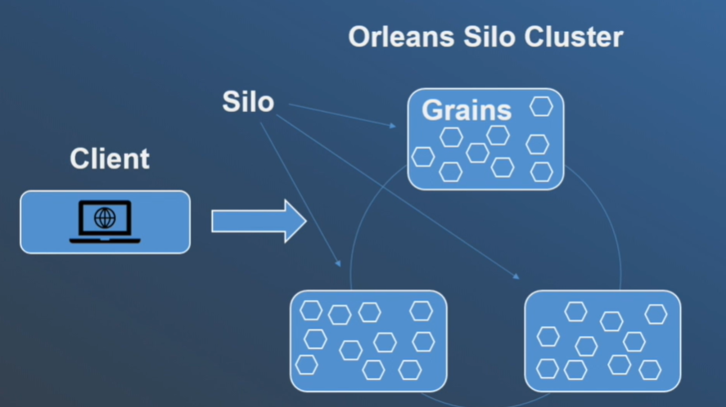
Microsoft Orleans
Orleans is a framework that provides a straightforward approach to build distributed, high scale computing applications without the need to learn and apply complex concurrency or other scaling patterns.
Orleans provide an intuitive way of building Stateful middle tier.
Various business logical entities appear as a sea of isolated global addressable .NET objects called grains.
Of different applications defined types distributed across cluster of servers called Silos.

Slide 3
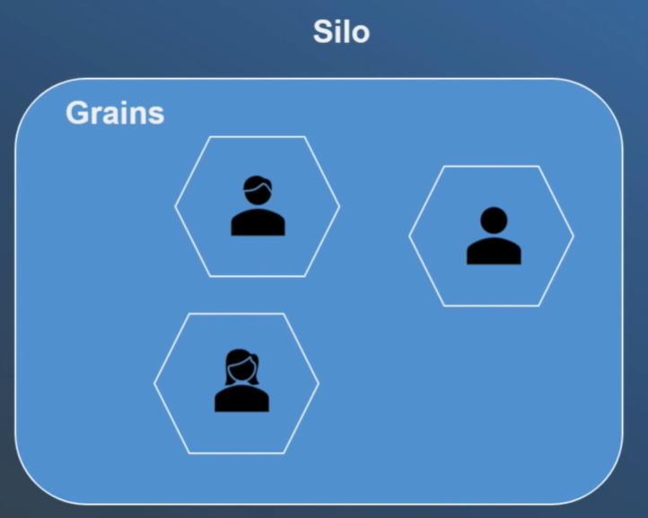
GRAINS
A grain type is a simple .NET class that implements one or more application type defined grain interfaces.
Individual grains are instances of application defined grain classes that get automatically created by Orleans runtime on servers. On needed basis to handle requests for those grains.
Grains naturally map to most application entities such as user, device, sessions, inventories.
These makes easy to build business logic that is object-oriented but scales transparently to a cluster of servers.

Slide 4
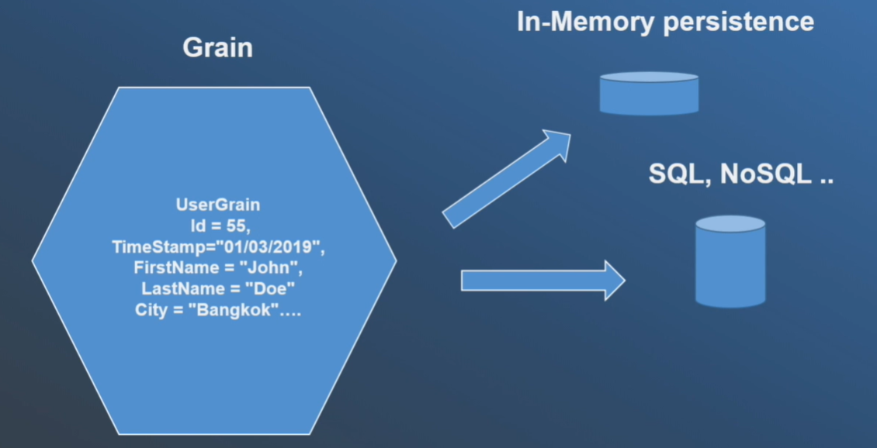
GRAIN
Each grain has a stable logical identity. Within its grain type chosen by the application logic.
For example: User email, Device ID
Orleans guarantees single thread execution of each individual grain and protects application logic from concurrency and race condition.
A grain can have a persistence storage. It can be in memory state or both.
Any grain can be called by other grain or frontend. By using targets grain logic identity without the need to ever create or instantiate a target grain.
The Orleans programming model make grains appear as if they are in the memory for the whole time.
In reality, the grain goes through the lifecycle from existing or from persisted state in a storage to be instantiated in a memory/being removed from memory.
Behind the scenes, the Orleans runtime instantiates the grains whenever there is a work for them to do. Removes them from the memory to reclaim hardware resources when the grains are idle or their for too long.

Slide 5
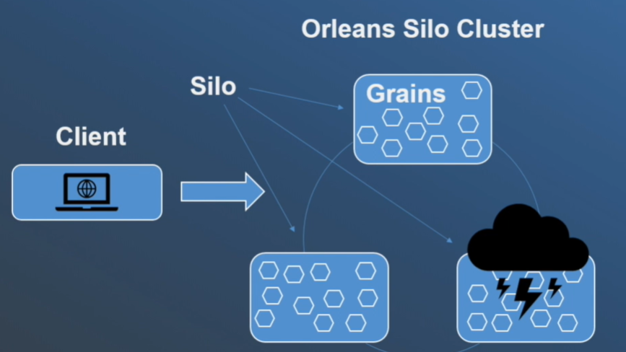
Failure of grains
In addition, the virtual nature of grains allows Orleans to handle server failures mostly transparently through application logic.
Because grains that were executing on fail server will automatically instantiate grains on the other servers in the cluster once the failure is detected,

Slide 6
App Setup and configuration

Slide 7
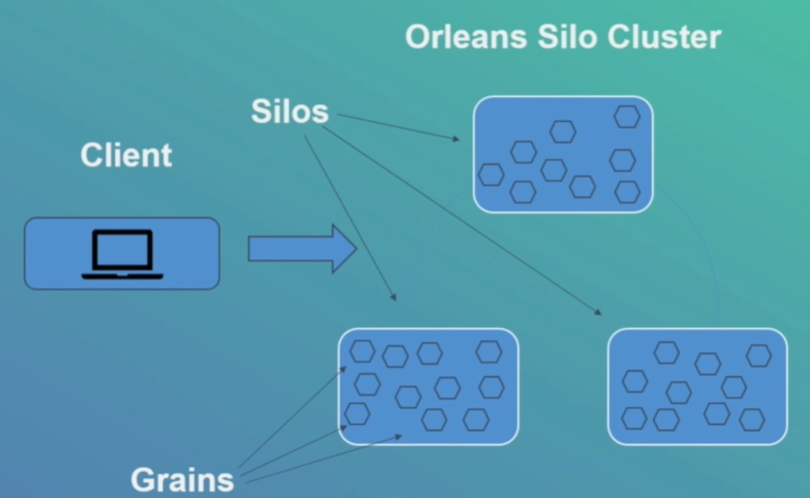
Silo
The term silo is used for application that houses grains. You can call it as Silo server.
Silos are used in the Cluster.
Client acts as connector to the silos and to the grains of the application.

Slide 8
Orleans APP STRUCTURE
Orleans App Structure | Nugets
Silo | Microsoft.Orleans.Server
Grains | Microsoft.Orleans.Core.Abstractions – Contains types implemented in Orleans runtime. Microsoft.Orleans.CodeGenerator.MSBuild
Interfaces | Microsoft.Orleans.Core.Abstractions Microsoft.Orleans.CodeGenerator.MSBuild

